Slide 1
Lecture 08 – Classification Models
Prof. André Gustavo Hochuli
gustavo.hochuli@pucpr.br
aghochuli@ppgia.pucpr.br
Notes:
Prof. André Hochuli

Slide 2
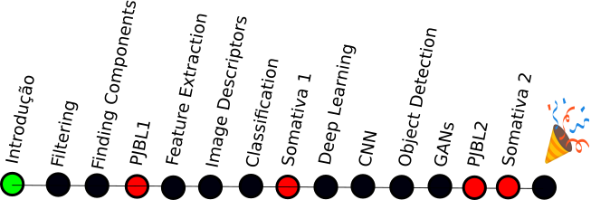
Topics
Discussion of Lecture #07
Image Descriptors
Classification Models
K-NN, Logistic Regression, Decision Trees Naïve Bayes, SVM and MLP
Evaluation Metrics
Accuracy, Precision, Recall and F1-Score
Practice
Computer Vision - Prof. André Hochuli
Lecture 08
Notes:
Prof. André Hochuli

Slide 3
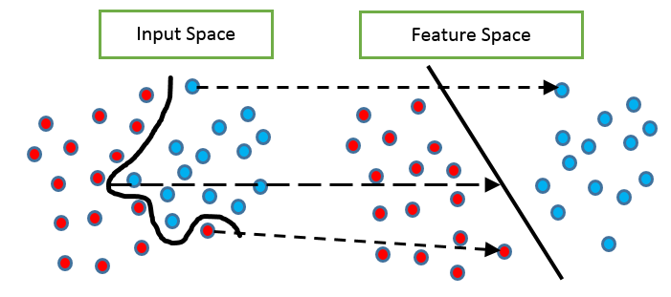
Problem
So far, we have extracted features from data to compute the feature space.
Computer Vision - Prof. André Hochuli
Lecture 08
Notes:
Prof. André Hochuli

Slide 4
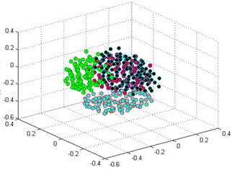
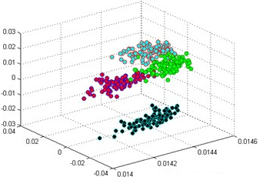
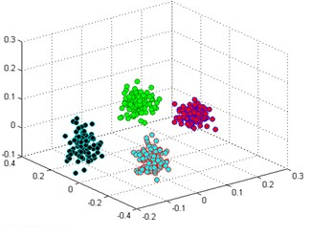
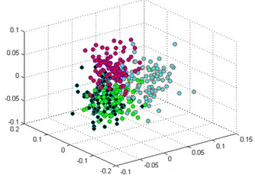
Problem
How discriminating are features?
Input Space
Feature Space’
Feature Space’’
Feature Space ’’’
Computer Vision - Prof. André Hochuli
Lecture 08
Notes:
Prof. André Hochuli

Slide 5
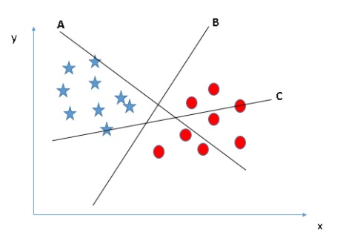
Problem
How to compute the decision boundary?
Computer Vision - Prof. André Hochuli
Lecture 08
Notes:
Prof. André Hochuli

Slide 6
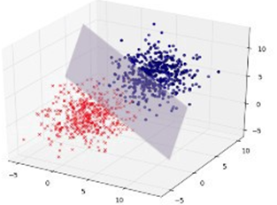
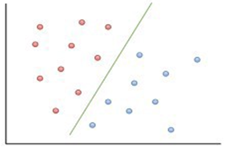
Problem
Hyperplane
2-D, 3-D … N-D (or N-Features)
Computer Vision - Prof. André Hochuli
Lecture 08
Notes:
Prof. André Hochuli

Slide 7
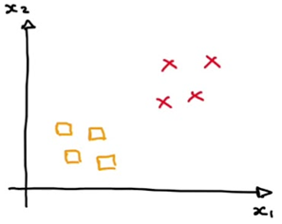
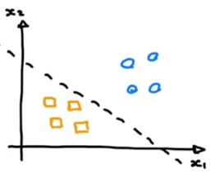

Problem
Binary Classification vs Multi-Class Classification
Computer Vision - Prof. André Hochuli
Lecture 08
Notes:
Prof. André Hochuli

Slide 8
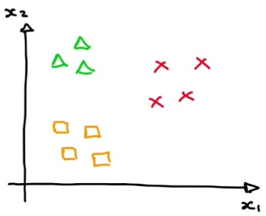
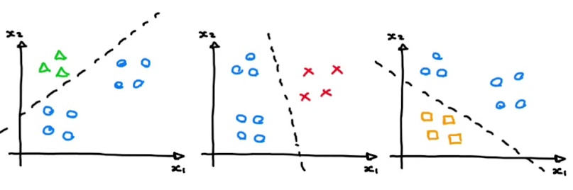
Problem
Binary vs Multi-Class
Computer Vision - Prof. André Hochuli
Lecture 08
Notes:
Prof. André Hochuli

Slide 9
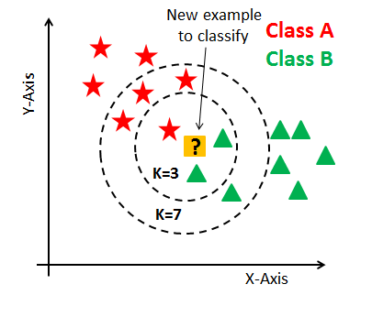
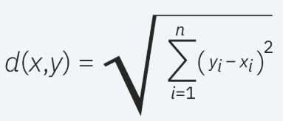
Classification Models
KNN
Computes the similarity in a feature space (Euclidian Distance, Manhattan….)
The K-Nearest Neighbors determines the class (Majority Vote)
There is no training step. Compute the distance of the test sample to each training sample
Computer Vision - Prof. André Hochuli
Lecture 08
Notes:
Prof. André Hochuli

Slide 10
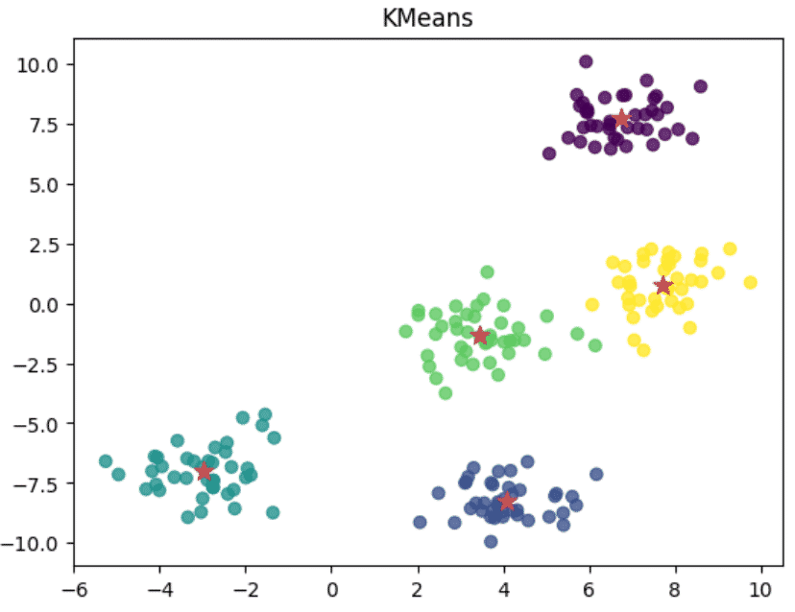
Classification Models
K-Means
Computes the distance between k-cluster
The clusters are defined in training step
Computer Vision - Prof. André Hochuli
Lecture 08
Notes:
Prof. André Hochuli

Slide 11
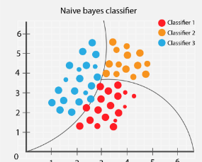
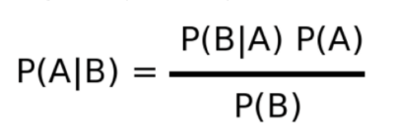

Classification Models
Naïve Bayes
Bayes Theorem
A priori vs Posteriori Probabilities
Computer Vision - Prof. André Hochuli
Lecture 08
Notes:
Prof. André Hochuli

Slide 12
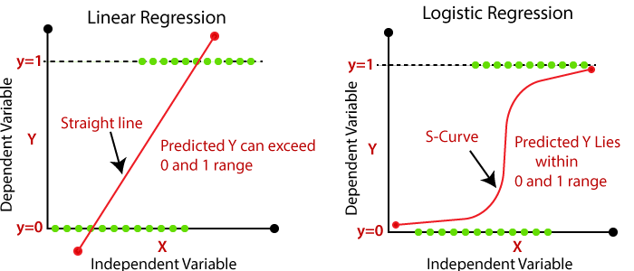
Classification Models
Logistic Regression
Linear vs Logistic
Computer Vision - Prof. André Hochuli
Lecture 08
Notes:
Prof. André Hochuli

Slide 13
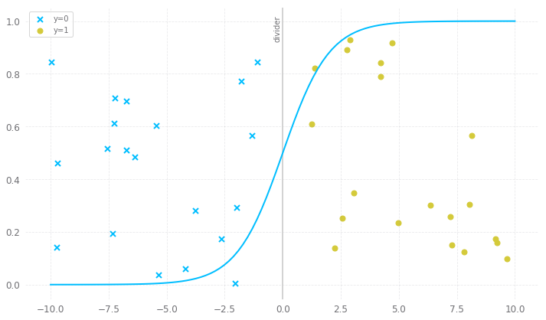
Classification Models
Logistic Regression (LR)
Logistic Boundary
Computer Vision - Prof. André Hochuli
Lecture 08
Notes:
Prof. André Hochuli

Slide 14
Classification Models
Logistic Regression (LR)
Logistic Boundary
Computer Vision - Prof. André Hochuli
Lecture 08
Notes:
Prof. André Hochuli

Slide 15
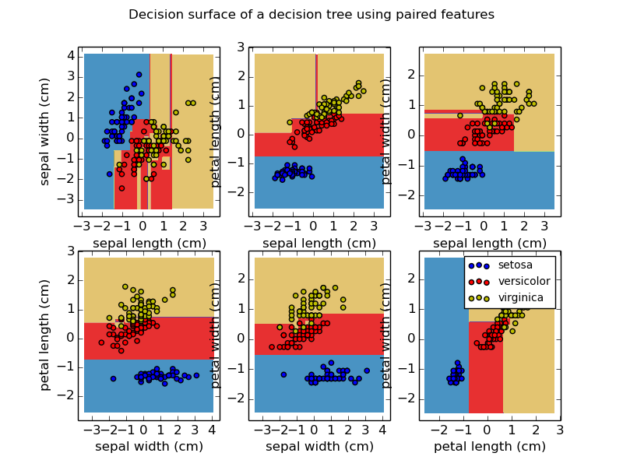
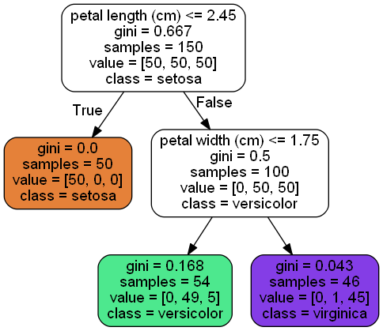
Classification Models
Decision Tree
Creates decision rules from the data features
Computer Vision - Prof. André Hochuli
Lecture 08
Notes:
Prof. André Hochuli

Slide 16
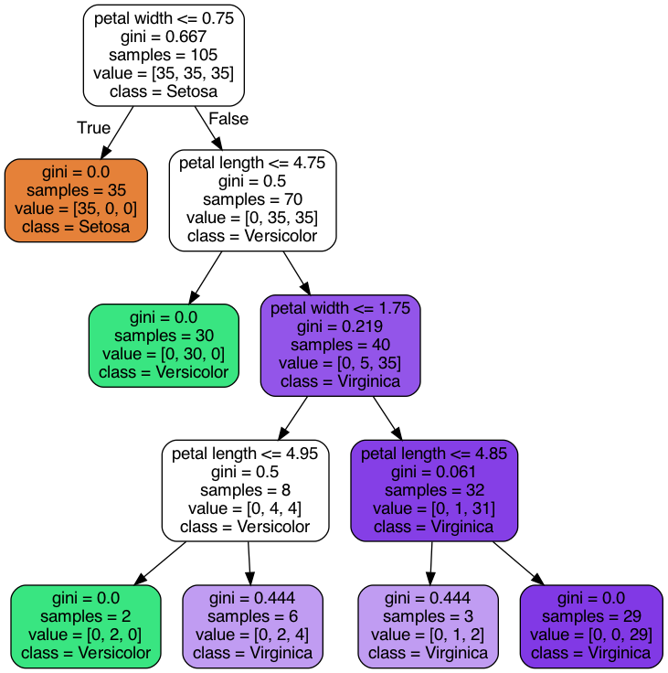
Classification Models
Decision Tree
Computer Vision - Prof. André Hochuli
Lecture 08
Notes:
Prof. André Hochuli

Slide 17
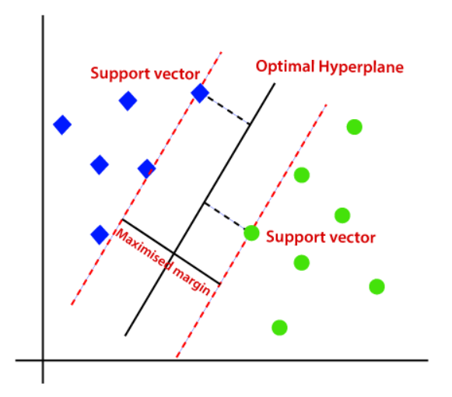
Classification Models
Support Vector Machine (SVM)
The support vectors determine the decision boundary
Computer Vision - Prof. André Hochuli
Lecture 08
Notes:
Prof. André Hochuli

Slide 18
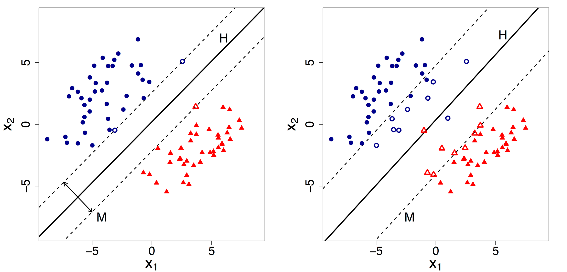
Classification Models
Support Vector Machine (SVM)
The support vectors determine the decision boundary
Hard Margin
Soft Margin
Computer Vision - Prof. André Hochuli
Lecture 08
Notes:
Prof. André Hochuli

Slide 19
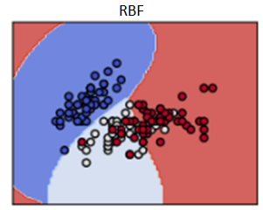
Classification Models
Support Vector Machine (SVM)
Kernels
Computer Vision - Prof. André Hochuli
Lecture 08
Notes:
Prof. André Hochuli

Slide 20
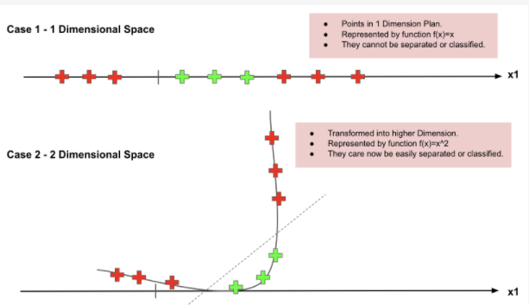
Classification Models
Support Vector Machine (SVM)
Kernel Trick
Computer Vision - Prof. André Hochuli
Lecture 08
Notes:
Prof. André Hochuli

Slide 21
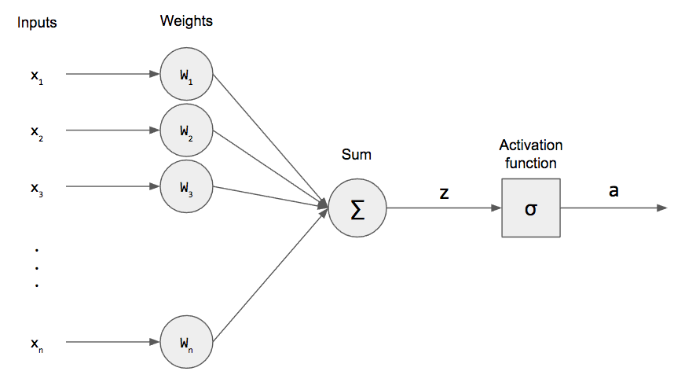
Classification Models
Multi-Layer Perceptron
Perceptron
Computer Vision - Prof. André Hochuli
Lecture 08
Notes:
Prof. André Hochuli

Slide 22
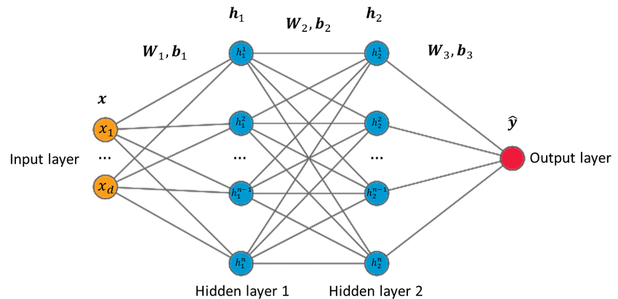
Classification Models
Multi-Layer Perceptron
Multi-Layer Perceptron (MLP)
Computer Vision - Prof. André Hochuli
Lecture 08
Notes:
Prof. André Hochuli

Slide 23
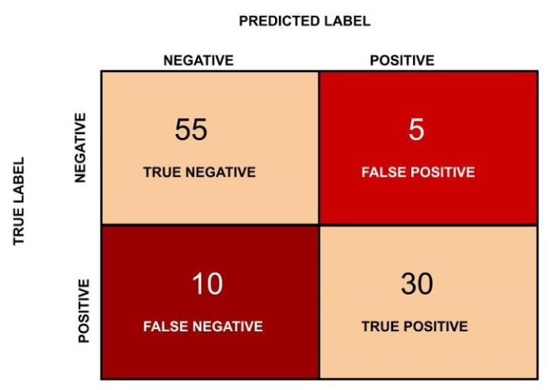
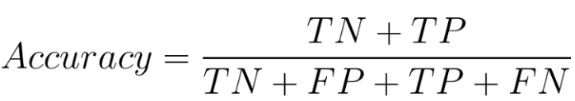
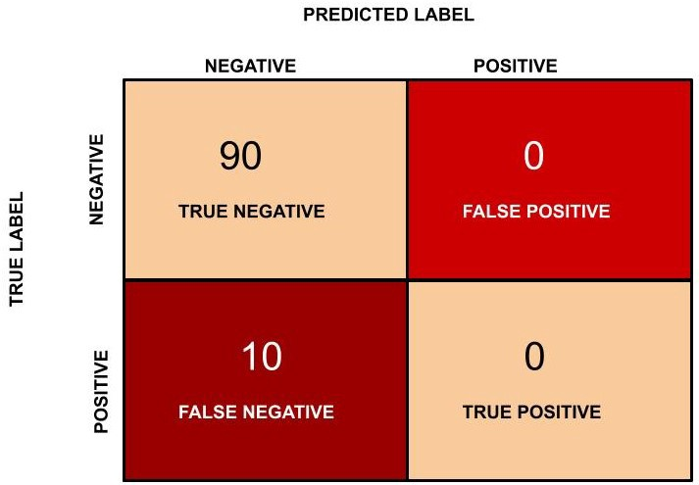
Evaluation Metrics
Accuracy:
Correctly classified instances over total instances
(55 + 30)/(55 + 5 + 30 + 10 ) = 0.850
What is the problem with accuracy?
Imbalanced Data
Acc: 90% (90/100)
Error TP: 100% (10/10)
Computer Vision - Prof. André Hochuli
Lecture 08
Notes:
Prof. André Hochuli

Slide 24
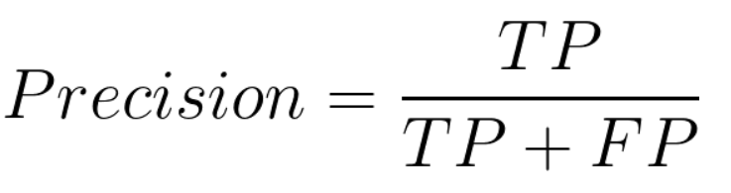
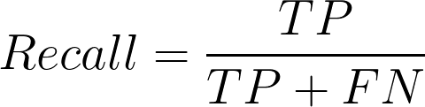
Evaluation Metrics
Precision:
Correctly positive classified instances over
positive predictions
30/(30+ 5) = 0.857
Recall
Correctly positive classified instances over
positive instances (A.K.A Sensitivity or TP Rate)
30/(30+ 10) = 0.750
Computer Vision - Prof. André Hochuli
Lecture 08
Notes:
Prof. André Hochuli

Slide 25
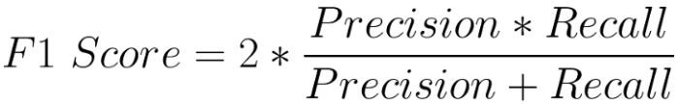
Evaluation Metrics
F1-SCORE:
Harmonic Mean^{(*)} of precision and recall rates
2* ( 0.857 * 0.75)/(0.857 + 0.75) = 0.799
Final Remarks
Accuracy: 0.850
F1-Score: 0.799
Precision: 0.857
Recall: 0.750
^{(*)} The harmonic mean is a method that gives less weightage to larger single values and more weightage to smaller values
Computer Vision - Prof. André Hochuli
Lecture 08
Notes:
Prof. André Hochuli

Slide 26
Let’s Code!
Lecture 08 - Image Classification.ipynb [LINK]
Computer Vision - Prof. André Hochuli
Lecture 08
Notes:
Prof. André Hochuli

